Slide 1
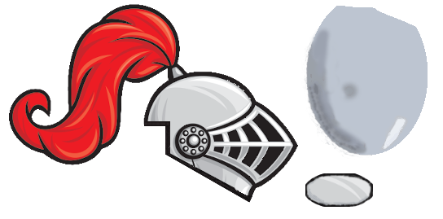

Team 4
Worms
smroW
By:
Alex ogilbee
Joseph Hill
Fernando Trevino

Slide 2
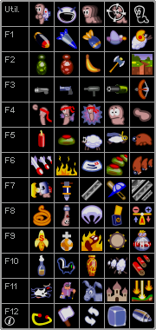
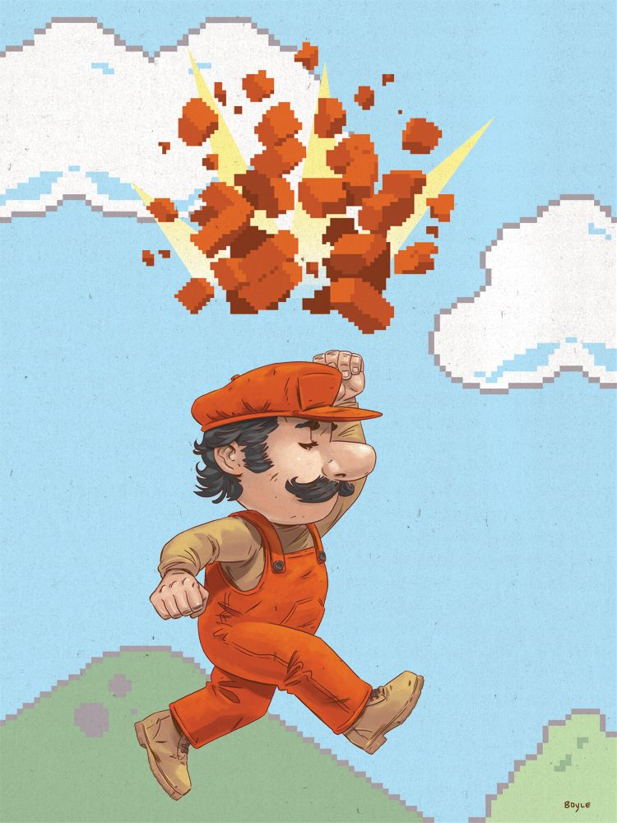
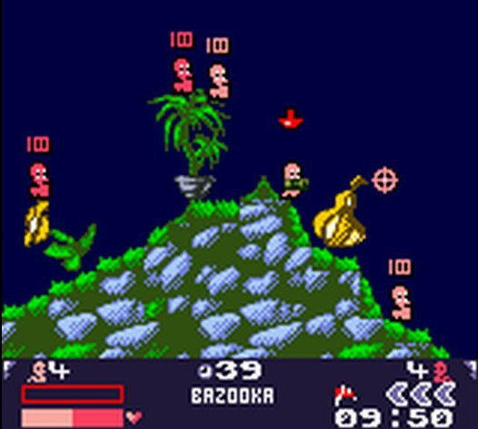
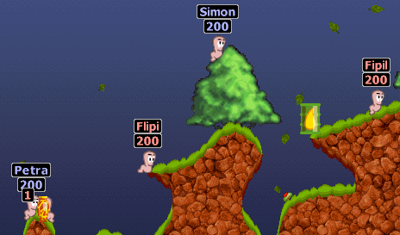
Game explanation
2D turn-based tactical shooter, inspired by Worms
Tile-based map
Each tile has its own health, not always destroyed on impact
Each map will have different environment behavior and hazards
Special weapons

Slide 3
Game Explanation
2D turn-based tactical shooter, inspired by Worms
Environment
Tile-based destroyable map
Environment adversaries such as the sun attacking you or water rising
Weapons and Tools
Arsenal of weapons shared by each team
Weapon Types: Gun, Launcher, Melee, Grenades
Tools: Teleporter, Tile Creator/Remover
Player Controls
WASD or Arrows for movement
Mouse for aiming

Slide 4


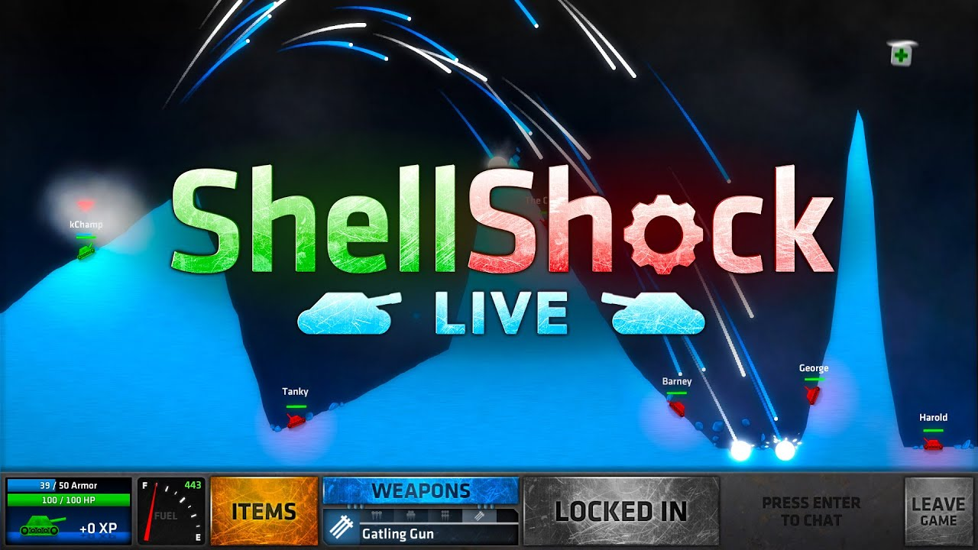

Game Decisions
Unity
Better than Game Maker and Unreal for 2D games (From what we know)
Prior experience
Why inspired by worms?
Popular game style
Turn-based system allows multiplayer with one computer

Slide 5
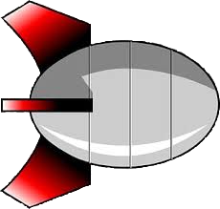

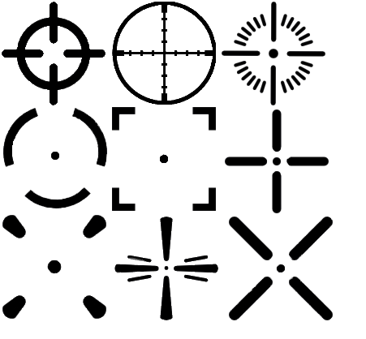









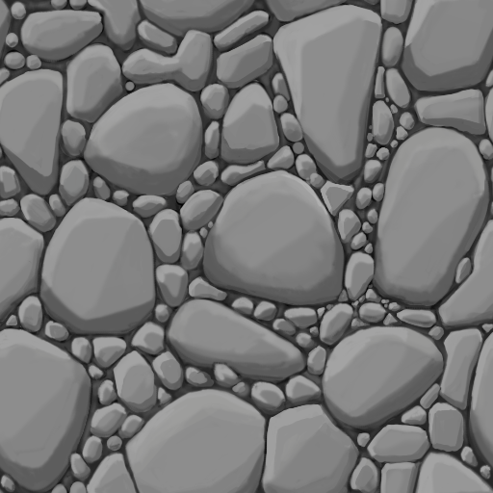

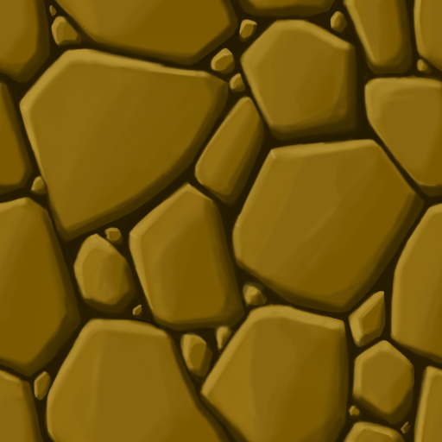
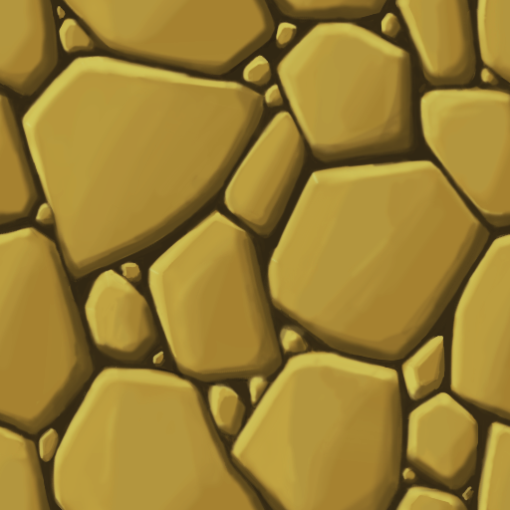
Art

Slide 6

Audio
We plan on finding fitting audio for ambient sounds, shooting, movement, the main menu, explosions, etc. from
Unity Asset Store
Itch.io
Freesound.org
If we can’t find existing sound FX we will make our own.

Slide 7
Task Breakdown
Alex
AI movement decisions, Menu screens, Weapon UI, Implementing weapon animations
Fernando
AI shooting decisions, Destructible terrain, Player controls, Physics mechanics, Collisions
Joseph
AI target decisions and weapon selection, Map Creation, Environment Interaction, Hazards and Sounds, WordPress Website

Slide 8
High-Level Schedule
9/18 Presentation Day
Site, GitHub, Art Style and Some Assets, Player movement
10/9 First Playable
One complete map, Core weapons implemented, PvP only, Player movement, Destructible terrain
11/18 Testing Day
Player AI implemented, procedural map generation, full menu, 10 weapons implemented, adversarial environment mechanics, Powerup spawning
12/11 Game Day
Adjust for player feedback, full weapon arsenal, AI difficulty levels, Settings Persistence

Slide 9
First Playable
One complete map
Core weapons implemented
PvP only
Player movement
Destructible terrain

Slide 10

Questions?

